Slide 1




Slide 2
London
Tristan J Barber
Royal Free Hospital, London UK

Slide 3

Background
The UK was one of the first countries to exceed UNAIDS 90-90-90 target
Estimated 102,000 people were living with HIV in the UK in 2017
New HIV diagnoses have continued to decline:
  2016: 5280
  2017: 4363 (down 17%)

Slide 4
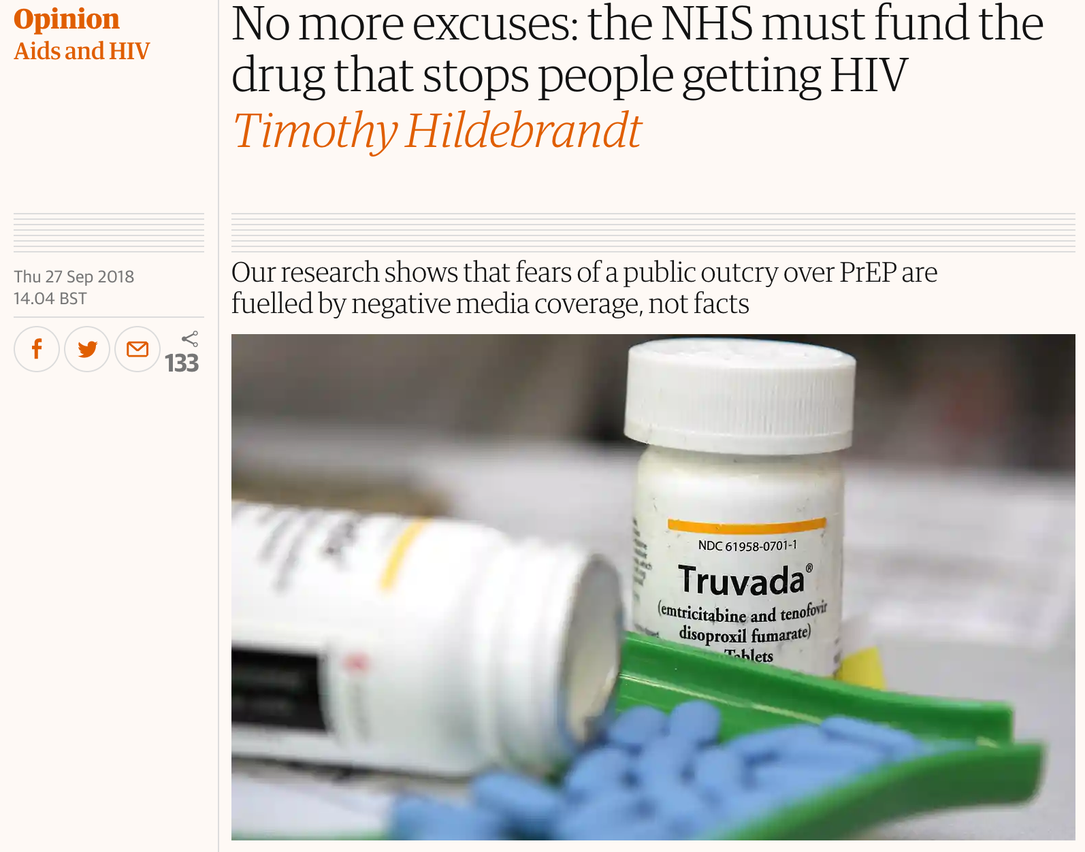

Slide 5
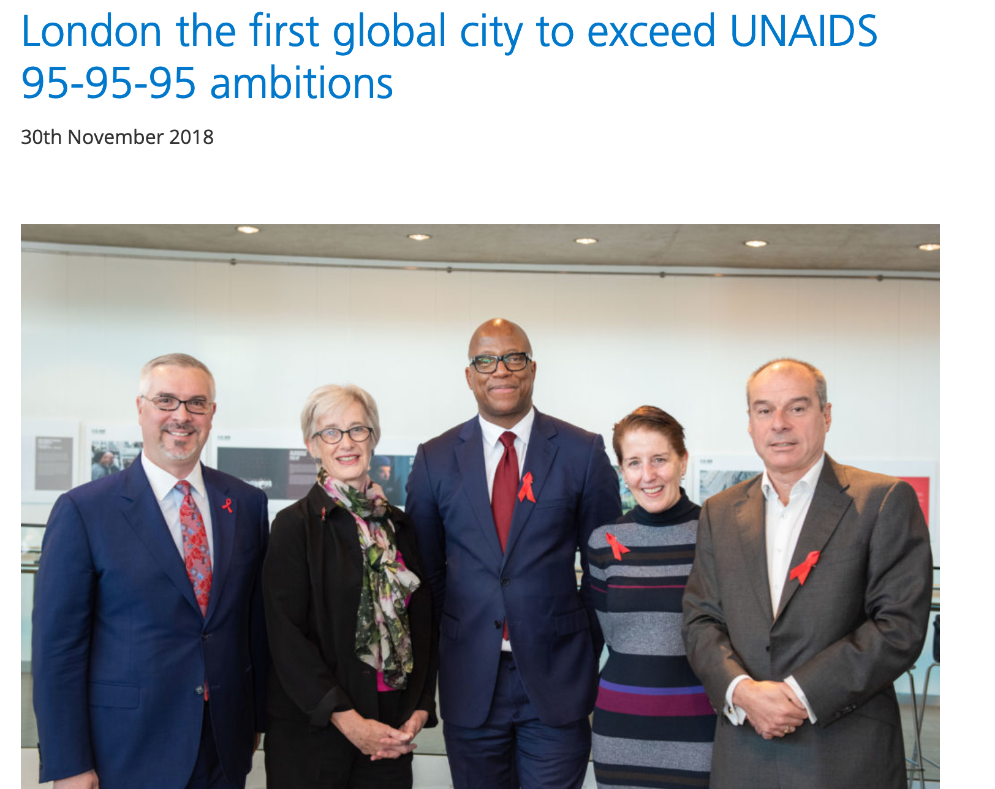

Slide 6
95-98-97
Notes:
Confirmed 2017 figures

Slide 7

London
HIV remains an important problem in London, with the infection impacting on Londoners more than any other part of the UK
In 2017, an estimated 38,600 people were living with HIV in London (diagnosed and undiagnosed)

Slide 8
London
HIV remains an important problem in London, with the infection impacting on Londoners more than any other part of the UK
In 2017, an estimated 38,600 people were living with HIV in London (diagnosed and undiagnosed)
5% (2,000) unaware of their infection

Slide 9
London
HIV remains an important problem in London, with the infection impacting on Londoners more than any other part of the UK
In 2017, an estimated 38,600 people were living with HIV in London (diagnosed and undiagnosed)
5% (2,000) unaware of their infection
An estimated 1,549 Londoners were newly diagnosed with HIV in 2017, accounting for 39% of new diagnoses in England

Slide 10
While this represents a fall of 22% from 2016, more needs to be done to eliminate HIV in London and especially to reduce the numbers of late HIV diagnoses

Slide 11
Timely diagnosis of HIV remains a challenge for London
Figure 4: Percentage of new HIV diagnoses that were diagnosed late by probable exposure category (A) and ethnic group (B), London residents, aged 15 years and over, 2014-2016*
HIV diagnosis
Source: Public Health England, HIV and AIDS New Diagnosis Database, HIV & AIDS Reporting System * Only includes new diagnoses for which CD4 count was reported within 91 days of diagnosis; late diagnosis defined as CD4 count <350 cells/mm3. The underlying population will impact on the proportion diagnosed late, e.g. MSM are less likely to be diagnosed late.
.
Notes:
Of particular concern that large proportion of people with HIV are diagnosed late in London
However, London compares favourably with the rest of England (34% from 2014 to 2016, compared to 40% in England).
In London, heterosexuals were more likely to be diagnosed late (57% of males, 50% of females) than MSM (23%).
By ethnic group, black Africans were more likely to be diagnosed late than the white population (53% and 25% respectively).
Over half of people who inject drugs were diagnosed late (57%).
People who are diagnosed late have a ten-fold risk of mortality within one year of diagnosis compared to those diagnosed promptly

Slide 12
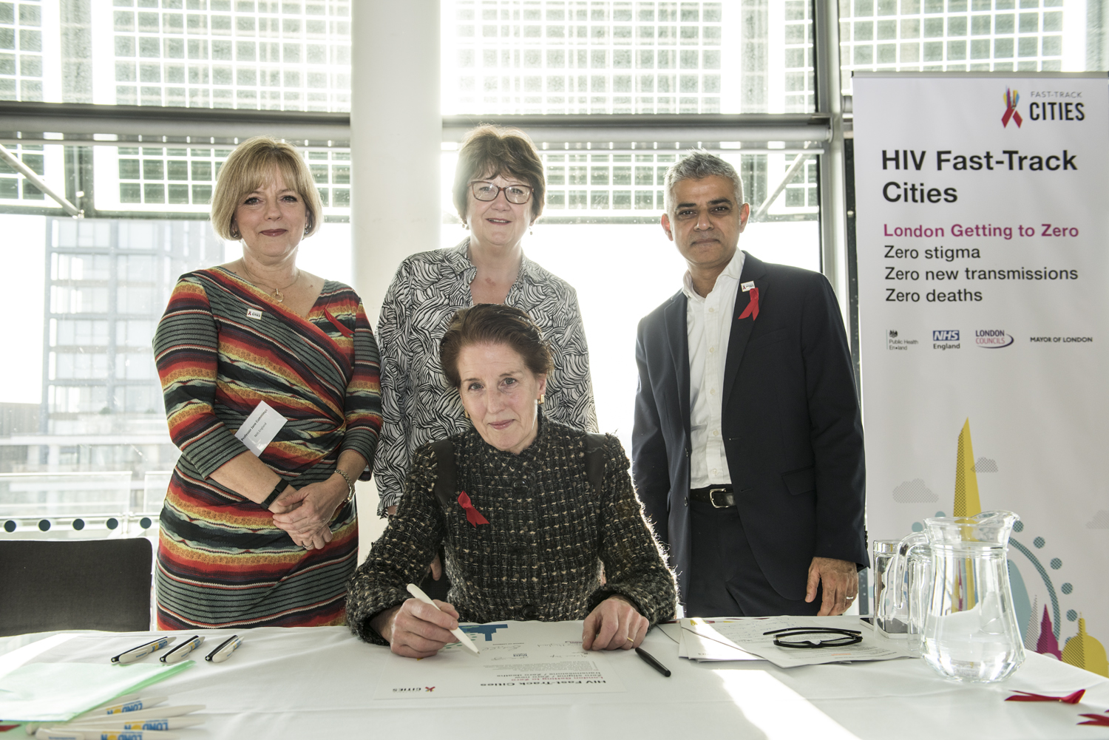
2018

Slide 13
London has set the ambitious target of achieving zero new HIV infections, zero preventable deaths and zero HIV related stigma and discrimination –
aiming to wipe out AIDS by 2030

Slide 14
Topics
Best practices and challenges in relation to HIV testing
Same-day ART initiation
Stigma elimination
Engagement/retention in care
Differentiated service delivery

Slide 15

Topics
Best practices and challenges in relation to HIV testing
Same-day ART initiation
Stigma elimination
Engagement/retention in care
Differentiated service delivery

Slide 16
HIV Testing
What are the challenges when already at (or above) 95-95-95?
Is opt out testing cost effective, or should we change strategy?
As the undiagnosed prevalence falls, so may the positive predictive value
  results in larger numbers needed to test to find an infection
  and an increase in false positivity….
Opportunity for prevention work with the increasing proportion who test HIV negative
  who/where/how?

Slide 17
HIV Testing
Remaining 5% may include many different people and groups:
  BAME MSM
  Diverse migrants
  Trans and gender diverse
  Heterosexual
Beware of majority signaling
  need awareness of limitations of current approaches and testing modalities

Slide 18

Self Testing
Costs THT about 6 times as much to get an HIV self-test order from a Black African compared to an MSM*
Specific to the approach
  paid adverts on billboards, buses, telephone boxes etc and social media marketing
Cost has been been reduced by better targeting
  eg Black African press
*Personal communication, Dr Michael Brady

Slide 19

Me. Him. Us
GMFA is a UK gay men’s health charity
“Me. Him. Us.” campaign is directed at gay black men in particular
GMFA’s campaign is one of the few public health campaigns directed at the queer BAME community
Sets out to change perceptions of BAME gay couples (and reduce stigma)

Slide 20



Slide 21

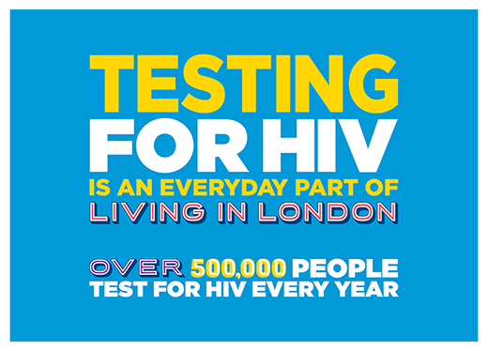

Slide 22
Same-Day ART initiation
Successes in some populations
  especially with patient satisfaction
But what is true impact on transmission?
  you have to be diagnosed to get early treatment
Since removing CD4 criteria we have all reduced time from diagnosis to treatment

Slide 23

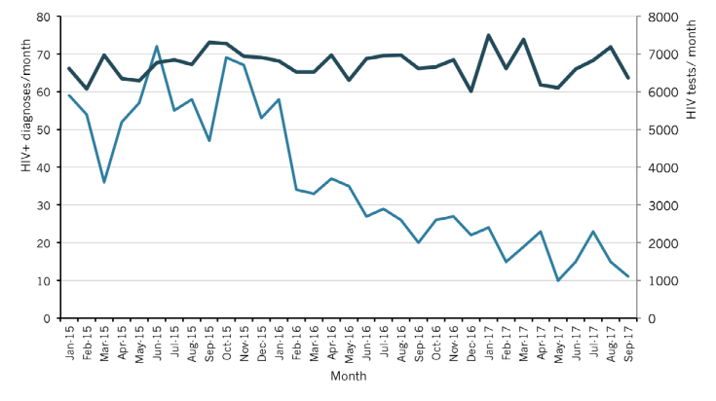
New HIV diagnoses at
56 Dean Street: 2015-2017
Personal communication: Dr Alan McOwan, Clinical Lead, 56 Dean Street

Slide 24
56 Dean Street - Summary
Rapid ART initiation deliverable
  26% attended within 48h
  Quicker ART initiation
  Patients are able to decline Rapid ART
50% primary HIV infection
Well informed MSM

Slide 25
56 Dean Street - Summary
Rapid ART initiation deliverable
  26% attended within 48h
  Quicker ART initiation
  Patients are able to decline Rapid ART
50% primary HIV infection
Well informed MSM

Slide 26


Slide 27

YouGov Survey
2,022 participants
86% heterosexual
9% identified as gay/bisexual

Slide 28
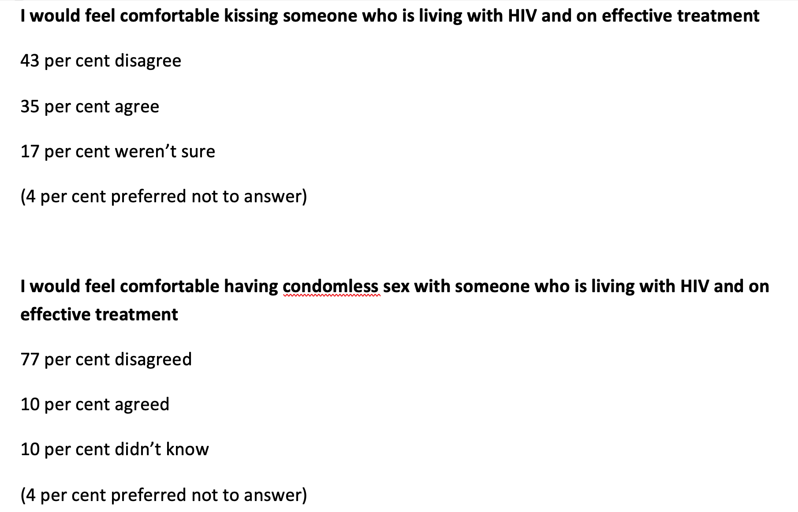

Slide 29
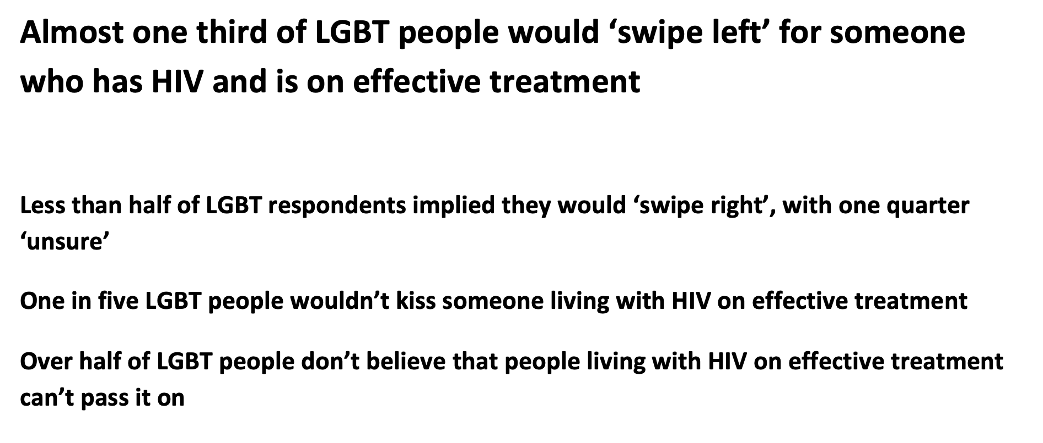

Slide 30
Stigma Elimination
The most difficult?
Media campaigns
  expensive
Reverse ‘don’t die of ignorance’ campaign
  on every TV
  in every letterbox

Slide 31


Slide 32
Engagement and Retention
Focus on key populations
  Migrants
  Homeless
  Drug and alcohol users
  Mental health

Slide 33
Differentiated Service Delivery
New models of care
Key population/community led
Coproducing, designing, and delivering services
Targeted marketing
Multi agency working
  not purely clinical solutions
  utilise community based organisations…
  …and not necessarily just those in HIV arena

Slide 34
Systems Leadership
Advocacy
Collaborative Delivery
Communication and Engagement

Slide 35
London
HIV system in London in complex
FTCI is the only place where the whole pathway comes together
London FTCI ambitions which go way beyond sustained virological suppression
Tremendous expertise of the voluntary sector in London
  activism is a driver of change

Slide 36
London - Key Focus Areas
Reducing stigma
  in the NHS and other government services
  tackling stigma amongst the general public
Finding new ways to work, and to work together, to make further strides in improving the 90-90-90 targets
  as well as the ‘4th 90’ – Living Well with HIV (QoL)

Slide 37
Summary
London has the tools to reduce incidence of HIV and support people to live well for longer with HIV
Different populations have different needs - different approaches
As incidence decreases overall, hidden/ lost voices more important than ever
Stigma remains a challenge across the whole pathway
Opportunity to build on our assets and understand where we can do things differently

Slide 38
Acknowledgements
Jane Anderson
Mike Brady
Jess Drummond
Ros Louth
Phil Samba
Paul Steinberg

Slide 39


